Slide 1
Database Translation
Karl Simon, Josh Rizika, Adham Popal

Slide 2
Our Project Defined
We used the GitHub API Events dataset and restructured it into an SQL database (sqlite3).
Aim to show new capabilities with a normalized dataset in SQL
Effectively analyze the dataset, and make observations/identify trends
Diagrams and explain our methodology in analyzing semi-structured data

Slide 3
Initial look at GitHub Events API and what it entails
The GitHub Events API is based around Event objects. These are JSON objects which contain properties and information about a specific action a user/repository takes.
PullRequest events, PushEvents, CreateEvents, etc.
Event objects contain payloads, which are themselves objects unique to the event type. They contain additional, specific information for the event they represent.
E.g. the PullRequest payload contains an object for the actual pull request that was made (created-date, branches, etc.), whereas a PushEvent payload contains a size value, for the number of commits in the push.

Slide 4
Design Approach
What is most in common and can it reduce redundancy in respect to how it is stored?
What is least in common?
How do we bring together what is least in common and what is most in common?
Unique identifiers?
Scalable infrastructure and keep it structured?
Edge cases in enforcement of structure?

Slide 5
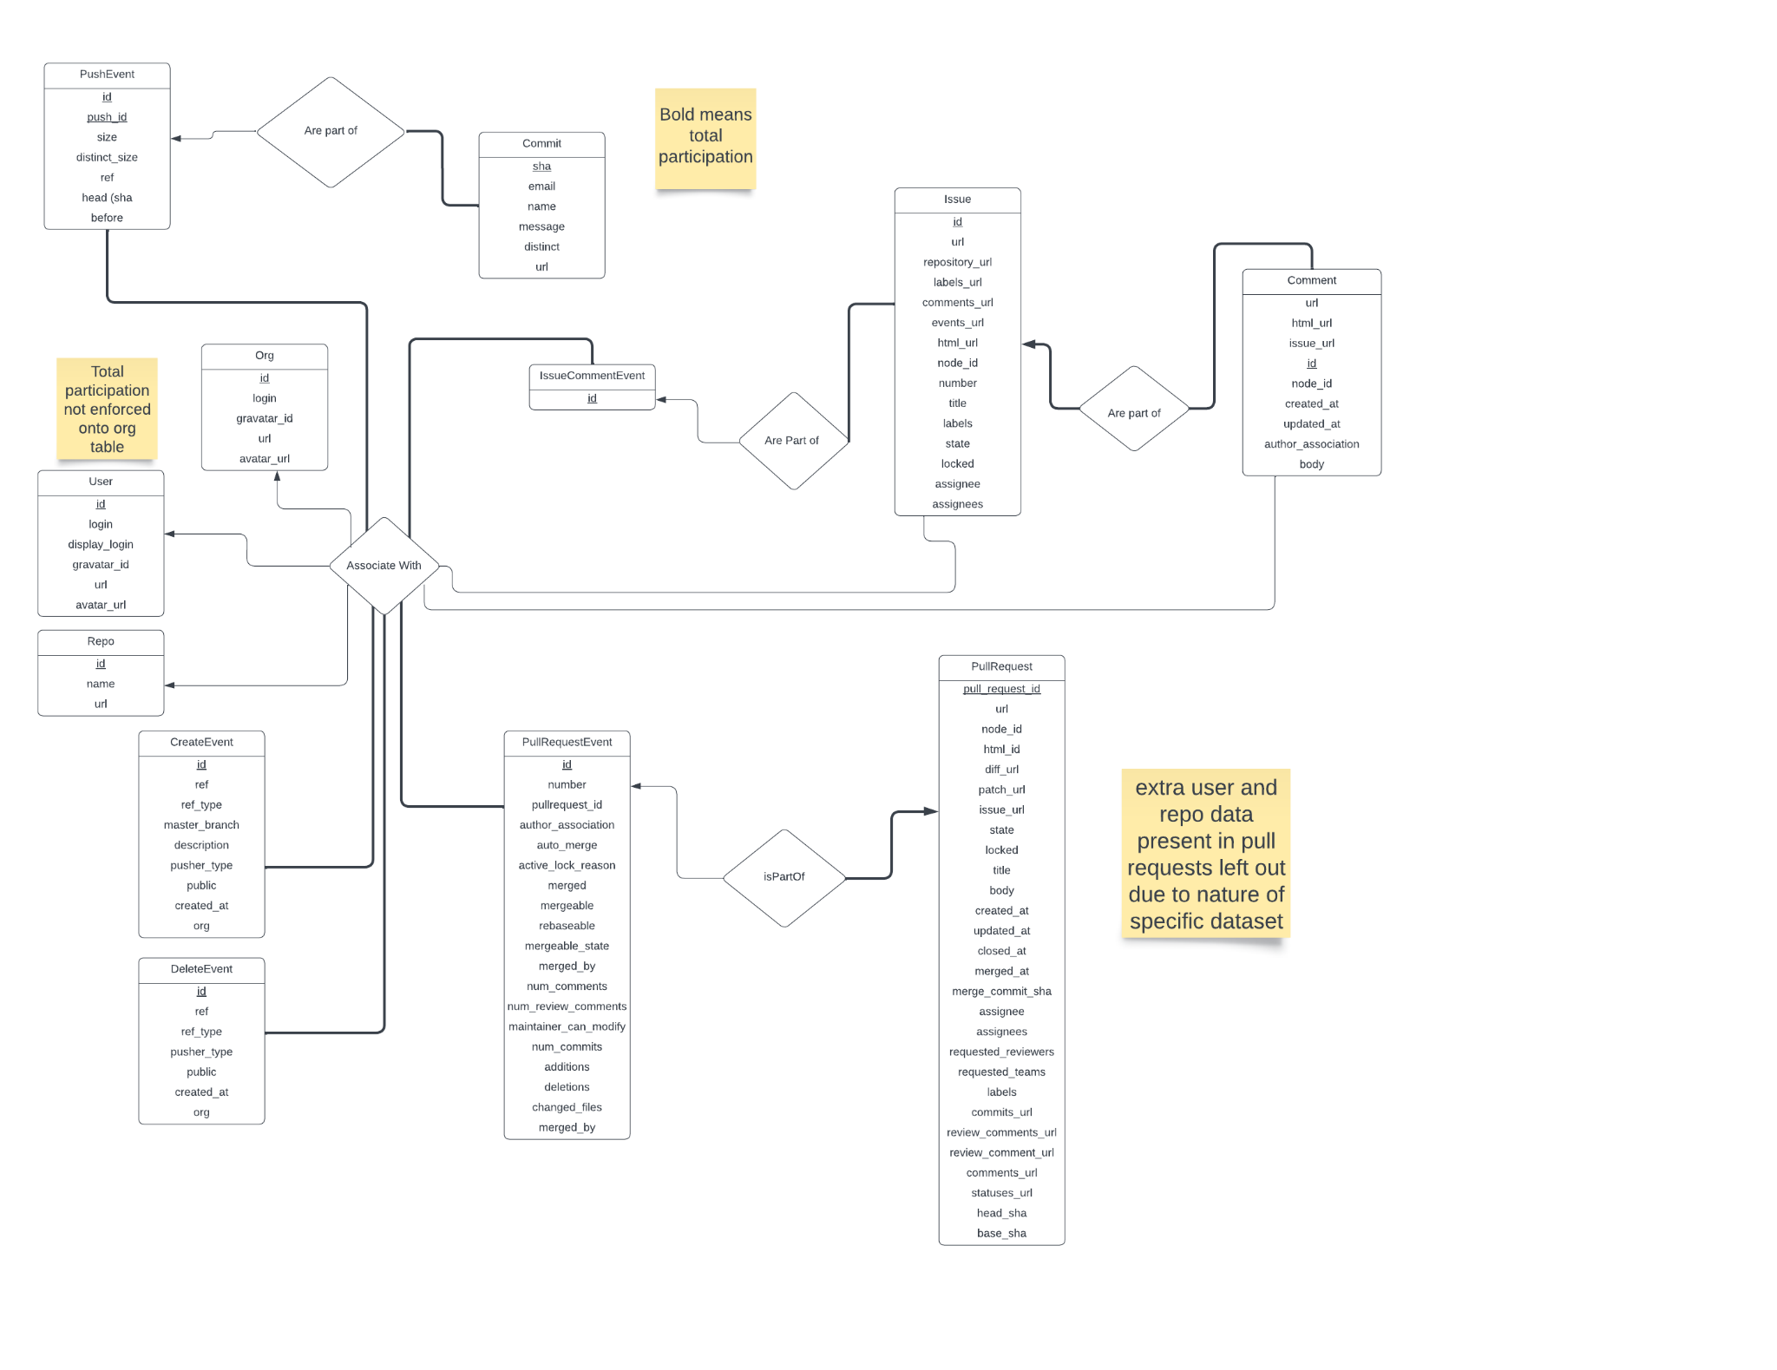
ER

Slide 6
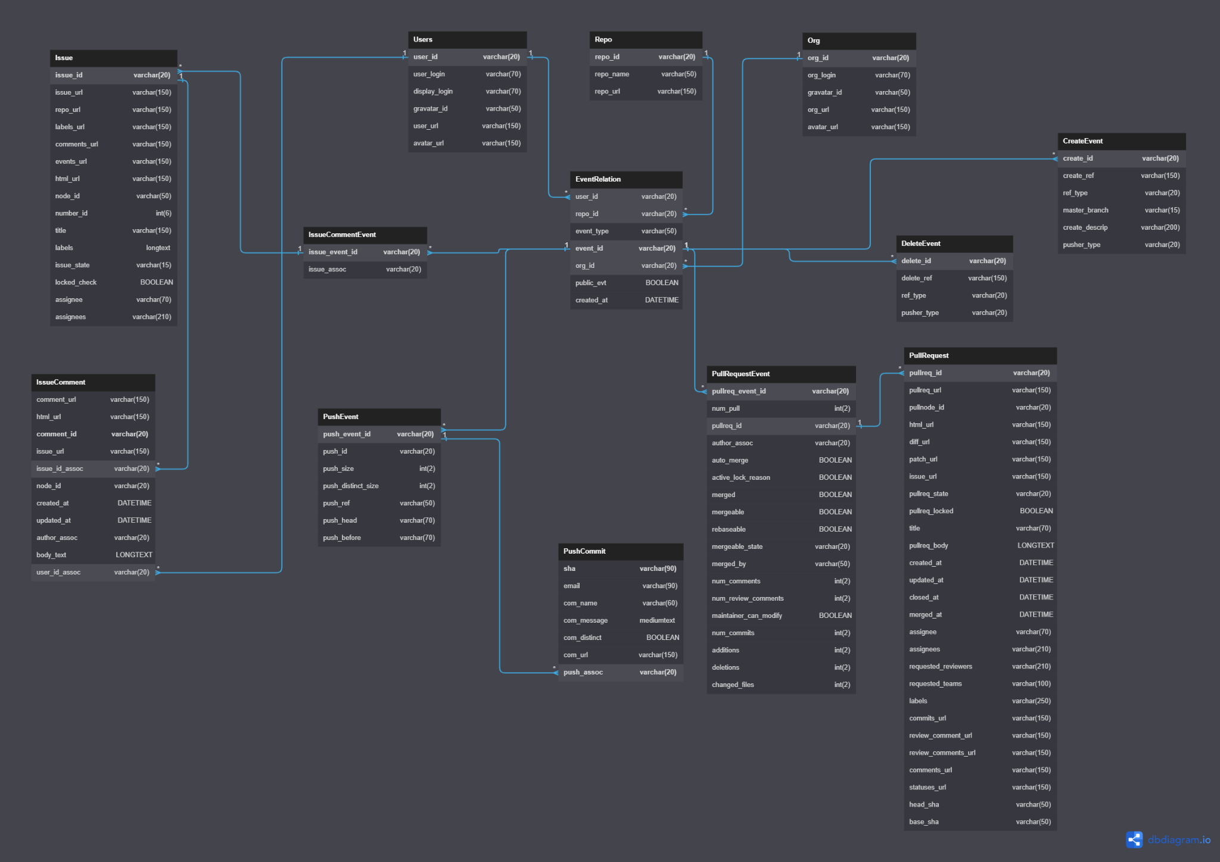
SQL

Slide 7
Normal Forms
Normal forms are labels that categorize the normalization proficiency of a DBMS. Each normal form has more specific rules and requires that the DBMS must be classified as the previous normal form to qualify for the next normal form.
1NF - Each cell contains one value and each column has a unique name.
2NF - A DBMS contains a primary key which uniquely identifies each row of data.
3NF - There is only one column that can be specified as a primary key meaning all data is only dependent on that primary key.
BCNF - Each column is only dependent on the one primary key. If there are any other dependencies between non primary keys, then they can be split into their own table to simplify using a foreign key to link the tables.
Using these guidelines when looking at our SQL schema, we can assert that our DBMS is in BCNF. Each cell contains one value and all column names are unique. Each table uses a primary key, all data is dependent on that primary key and all data that is dependent on another key is separated into its own table of data.

Slide 8
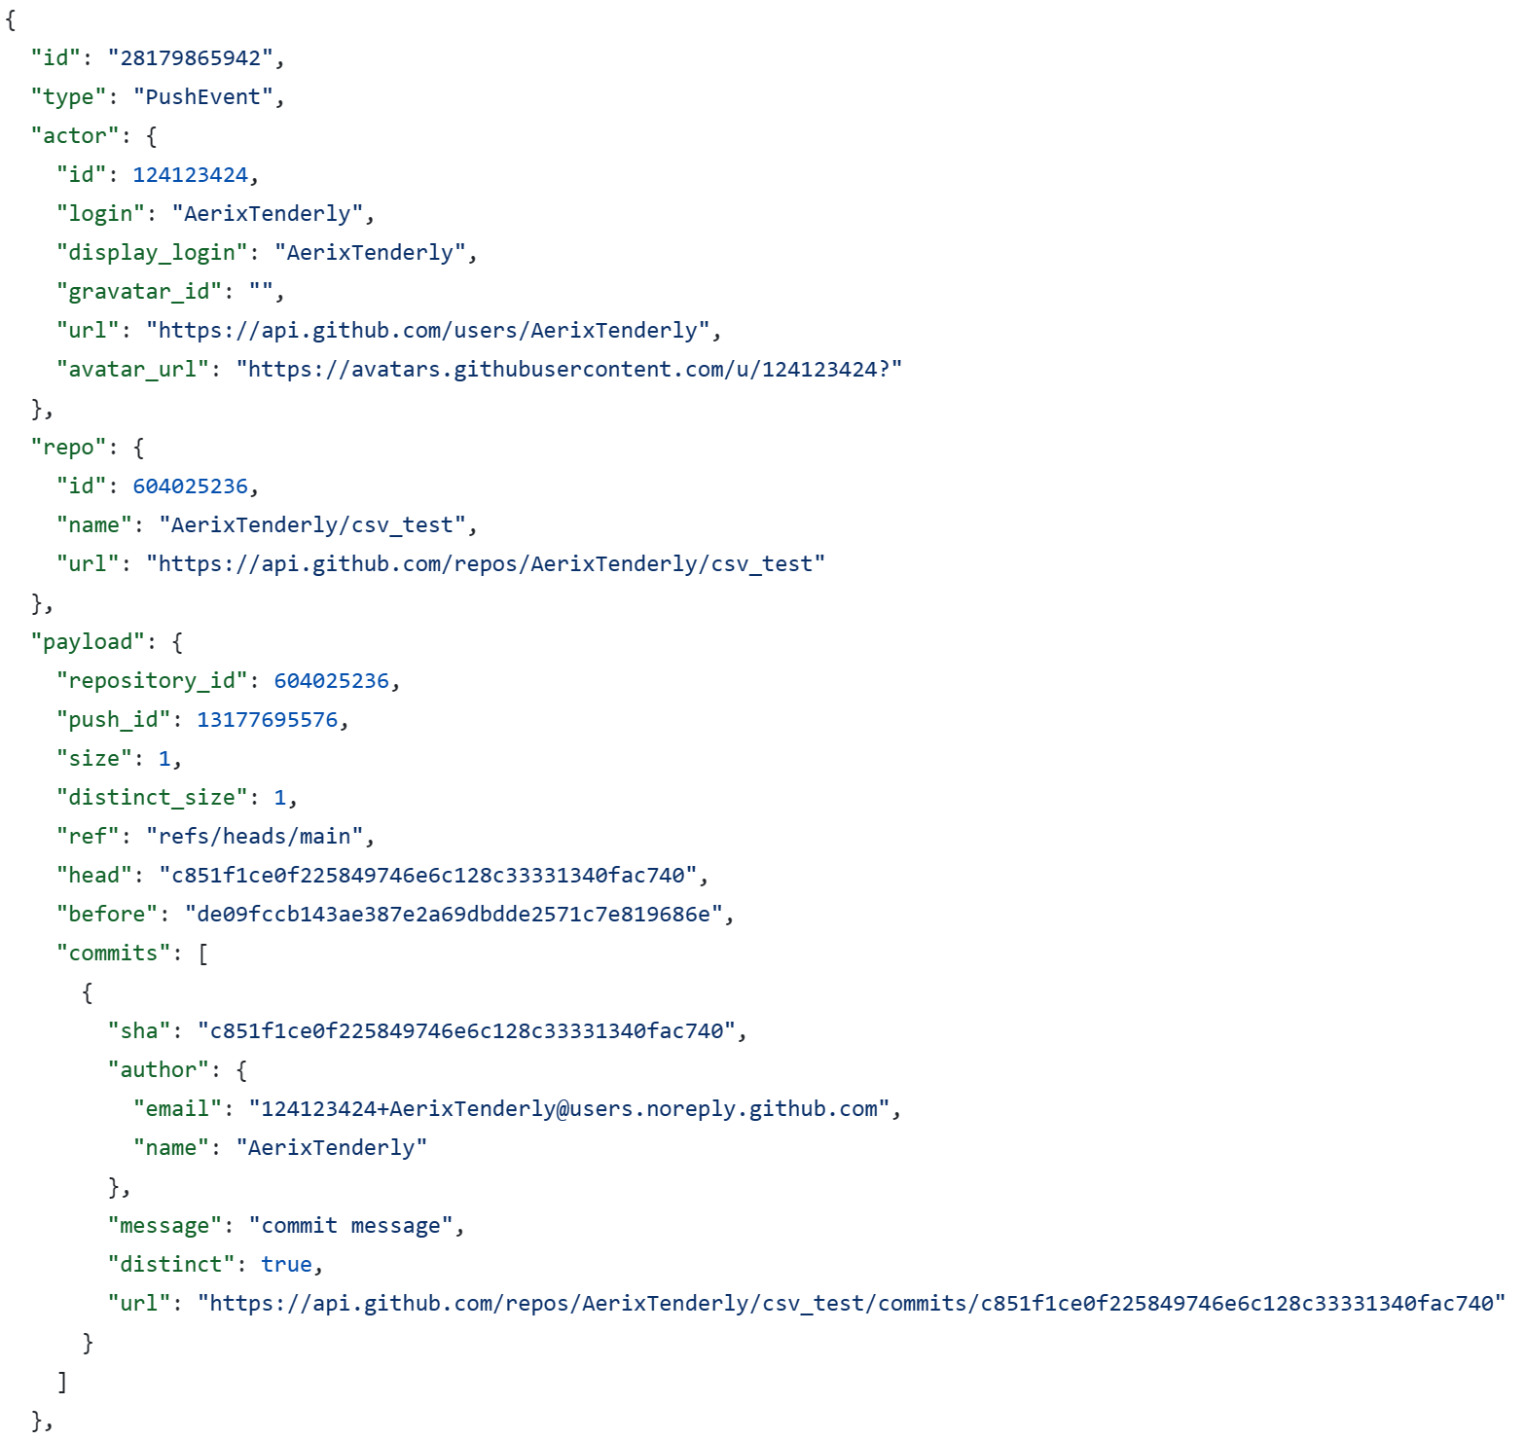
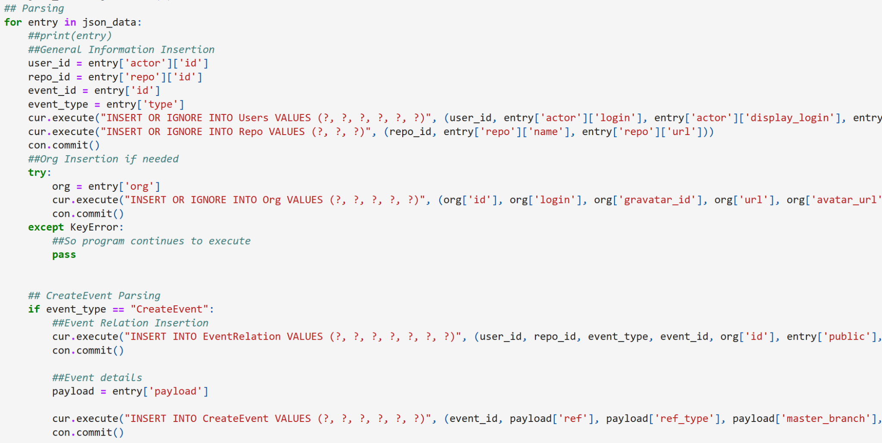
Code Samples
events.json structure
JSON to SQL translation

Slide 9
New Analysis Enabled
Restructuring the data significantly reduces data redundancy.
E.g. every event contains the information in the EventRelation table, so it doesn’t need to be stored in each Event separately.
In this dataset, information from one event references several other objects, so a normalized structure allows for quicker access to related information.
E.g. PullRequestEvents refer to specific Pull Requests
E.g. IssueCommentEvents contain the comment object and the issue object
Restructuring the JSON data allowed us to notice a trend in the Events dataset; it was dominated by one user in one Org, namely user_id=29139614.

Slide 10
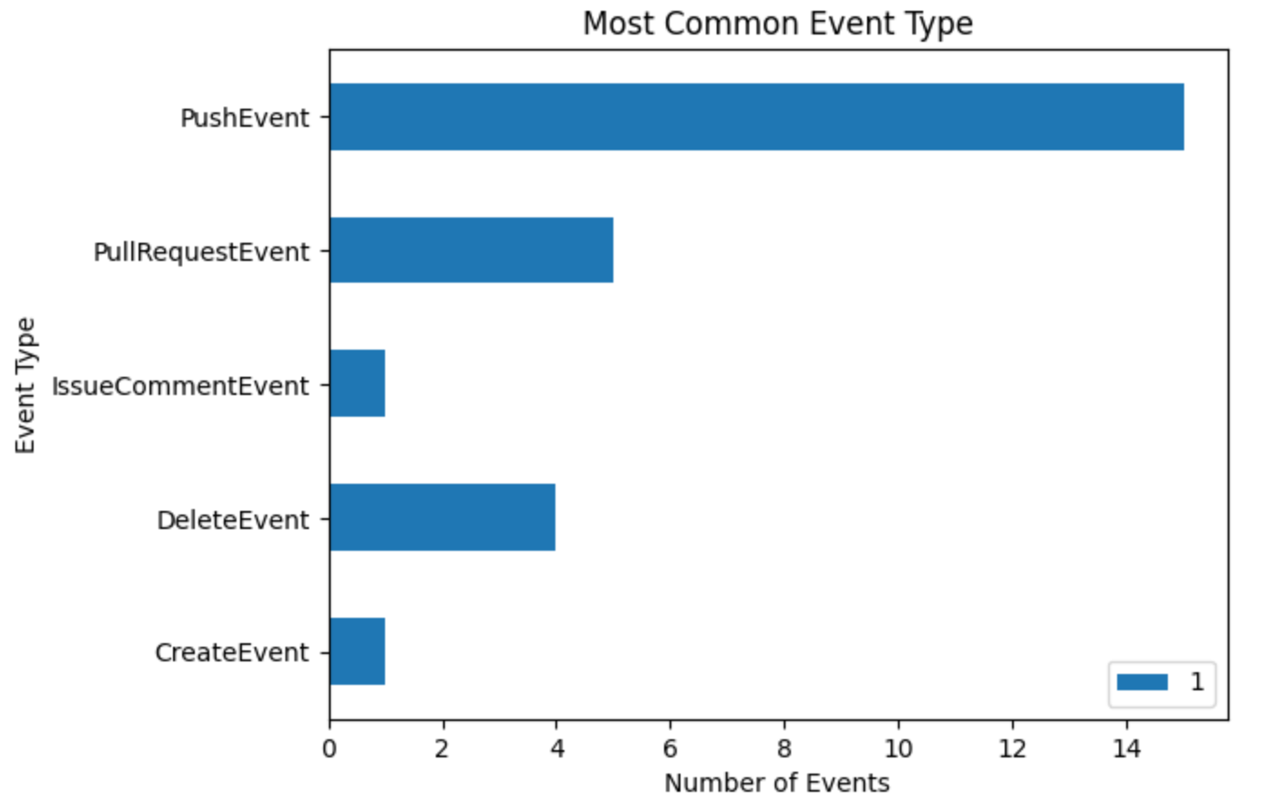
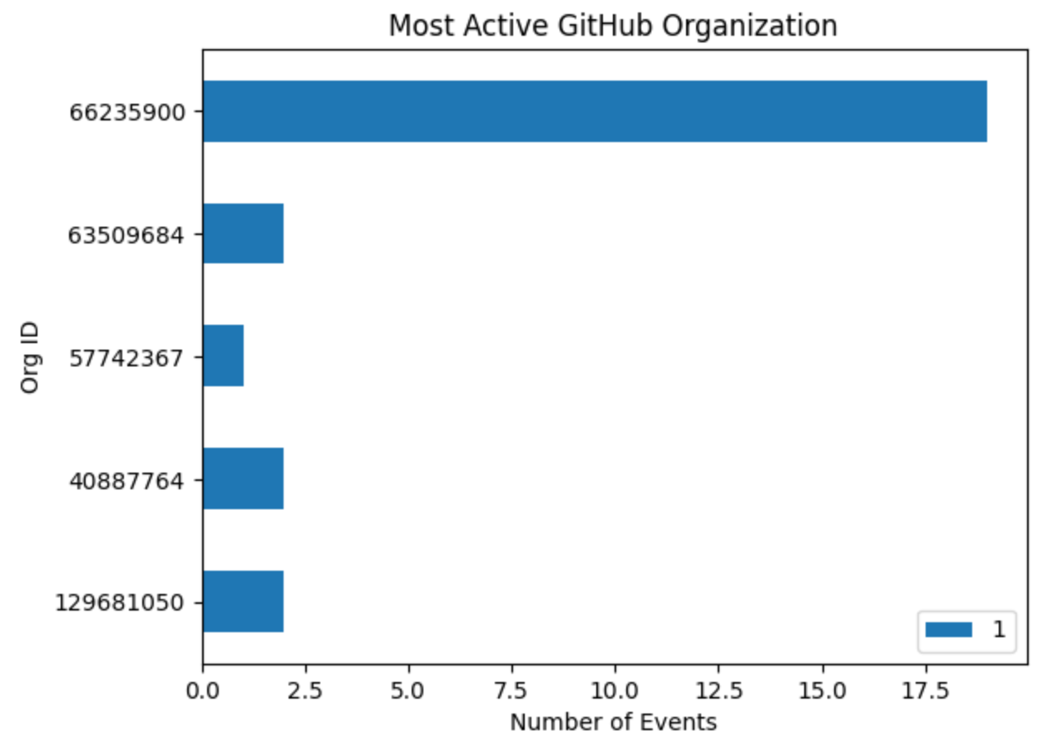
Example of Metrics able to collect
Number (and types) of events generated by a user
Most common event made by users
Most Active GitHub Org
Mostly user_id=29139614
Notes:
If we were looking to analyze things like pullrequests, we would need a larger dataset

Slide 11
Tradeoffs/challenges
JSON:
Pro: Less infrastructure requirements (just a single file)
Con: To insert into a JSON file requires modifying the single file, which is a security vulnerability for other data in the file.
Con: very inefficient querying and aggregation
SQL:
Pro: Allows us to make complex queries to extract more meaningful trends
Con: Normalization can be challenging
Con: inflexibility (data format cannot change)

Slide 12
Q/A

